Slide 1

VALLURUPALLI NAGESWARA RAO VIGNANA JYOTHI INSTITUTE OF ENGINEERING AND TECHNOLOGY
Department of Computer Science and Engineering
MACHINE LEARNING
Dr. Kriti Ohri
Assistant Professor
Department of Computer Science and Engineering

Slide 2
Learning Objectives
Performance measures of regression models
Understanding Coefficient of Determination
2

Slide 3
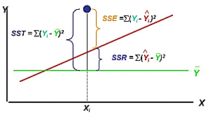

Slide 4
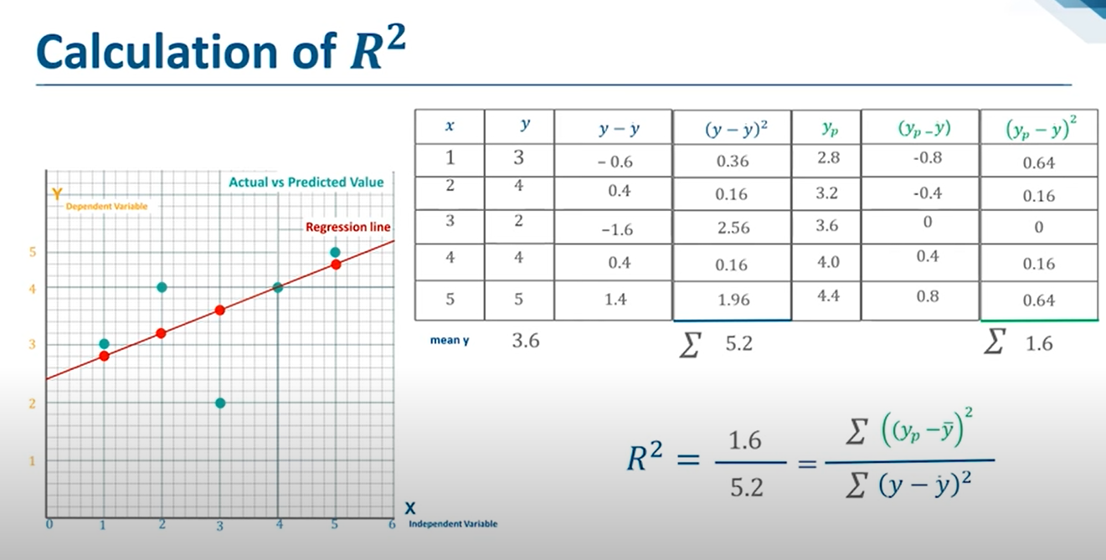

Slide 5


Coefficient of Determination
Relationship Among SST, SSR, SSE
SST = SSR + SSE
where:
SST = total sum of squares
SSR = sum of squares due to regression SSE = sum of squares due to error

Slide 6


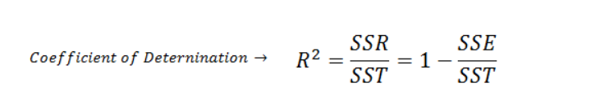
Coefficient of Determination
Explained error/total error
The coefficient of determination is:
r² = SSR/SST
where:
SSR = sum of squares due to regression
SST = total sum of squares

Slide 7
Coefficient of Determination
r² = SSR/SST = 100/114 = .8772
The regression relationship is very strong; 88% of the variability in the number of cars sold can be explained by the linear relationship between the number of TV ads and the number of cars sold.
0 to 1 is the interval of r²

Slide 8
Simple Linear Regression
Example: Auto Sales
Number of
TV Ads
1
3
2
1
3
Number of Cars Sold
14
24
18
17
27

Slide 9
Coefficient of Determination
r² = SSR/SST = 100/114 = .8772
The regression relationship is very strong; 88% of the variability in the number of cars sold can be explained by the linear relationship between the number of TV ads and the number of cars sold.

Slide 10


Sample Correlation Coefficient
^{r}xy
= (sign of b₁ )
Coefficient of Determination
_{r} 2
r_{xy} = (sign of b₁ )
yˆ = b₀ + b₁ x
where:
b₁ = the slope of the estimated regression equation

Slide 11



Sample Correlation Coefficient
_{r} 2
r_{xy} = (sign of b₁ )
The sign of b₁ in the equation
yˆ = 10 + 5x
is “+”.
^{r}xy
= + .8772
r_{xy} = +.9366

Slide 12



Assumptions About the Error Term e
The error e is a random variable with mean of zero.
The values of e are independent.
The error e is a normally distributed random
variable.

Slide 13
Agenda
Estimation, Prediction of Regression Model Residual Analysis: Validating Model Assumptions - II

Slide 14
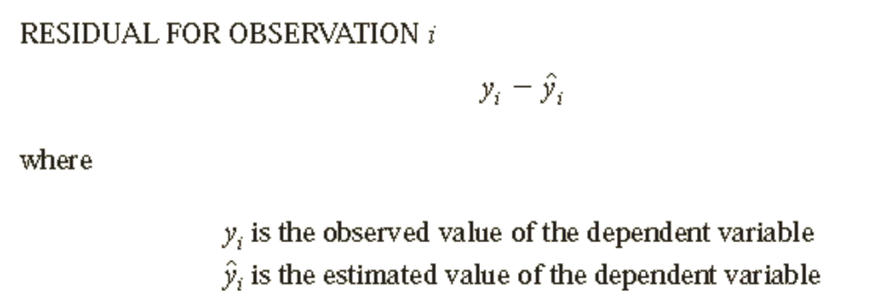
Residual Analysis: Validating Model Assumptions
Residual analysis is the primary tool for determining whether the assumed regression model is appropriate

Slide 15

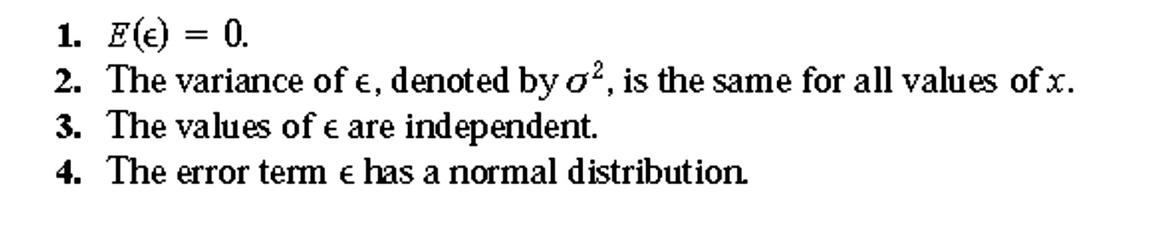
Assumptions about the error term .ξ

Slide 16
Importance of the Assumptions
These assumptions provide the theoretical basis for the t test and the F test used to determine whether the relationship between x and y is significant, and for the confidence and prediction interval estimates
If the assumptions about the error term ξ appear questionable, the
hypothesis tests about the significance of the regression relationship and
the interval estimation results may not be valid.

Slide 17
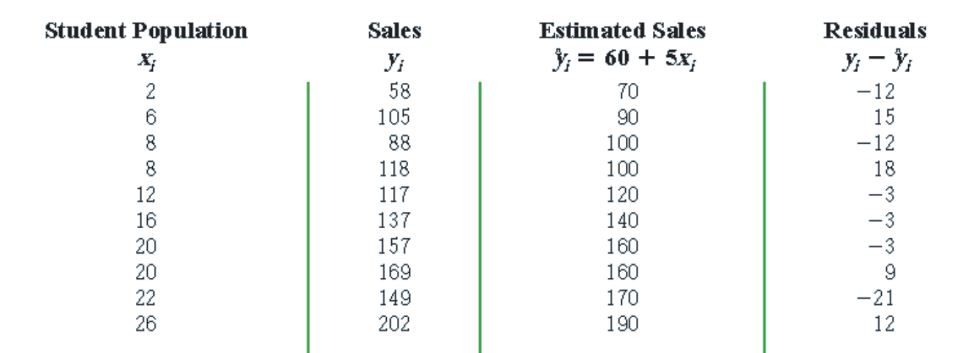
Residuals for Ice cream parlours
Source: Statistics for Business & Economics, David R. Anderson, Dennis J. Sweeney, Thomas A. Williams, Jeffrey D. Camm, James J. Cochran, Cengage Learning,2013

Slide 18
Residual analysis is based on an examination of graphical plots
A plot of the residuals against values of the independent variable x
A plot of residuals against the predicted values of the dependent variable
^
y

Slide 19
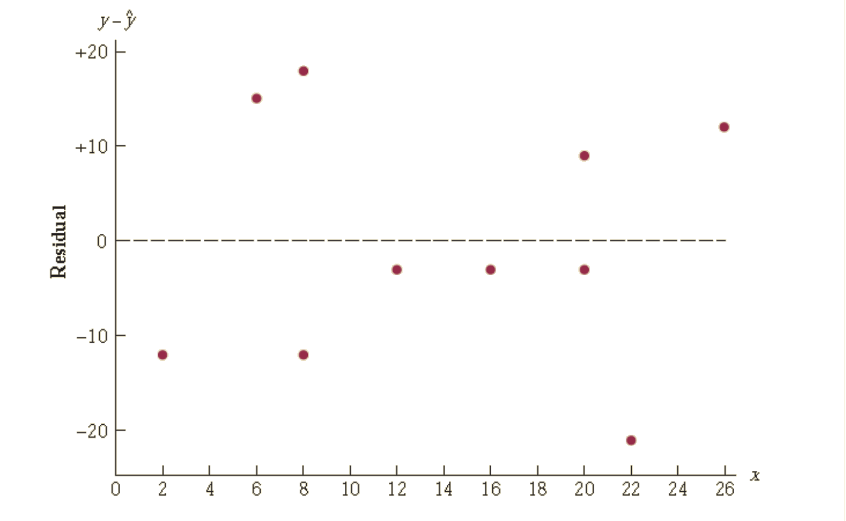
Residual Plot Against x

Slide 20
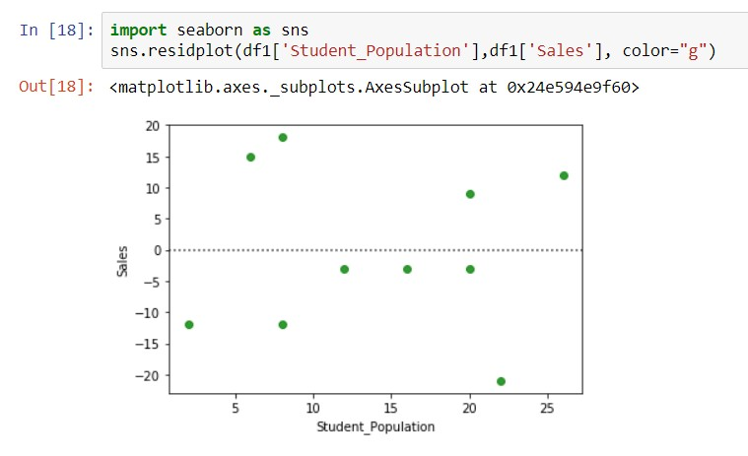
Residual Plot Against x

Slide 21
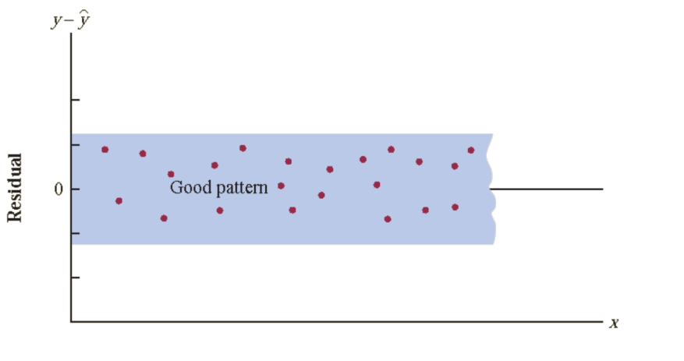
Assumption: the variance is the same for all values of x
The residual plot should give an overall impression of a horizontal band of points

Slide 22
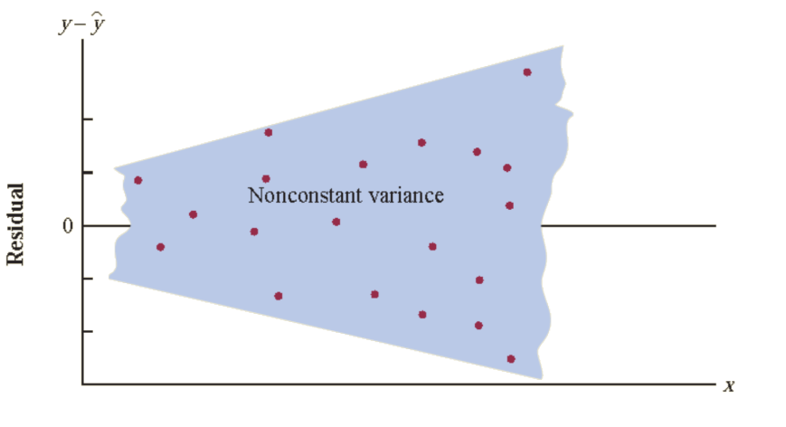
Violation of Assumption:
The variance of ‘e’ is not the same for all values of x
Assumption of a constant
variance of ‘e’ is violated
If variability about the regression line is greater for larger values of x

Slide 23
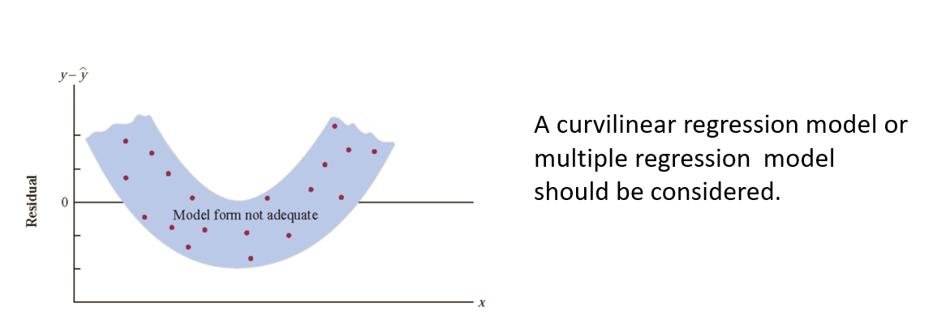

Slide 24
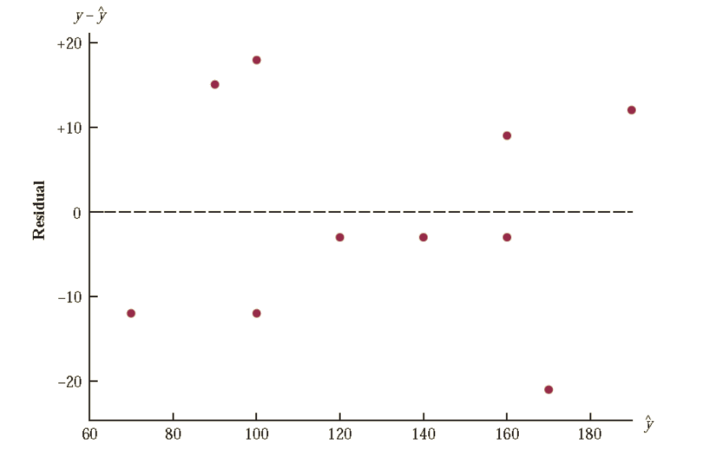
Residual Plot Against
^
y
The pattern of this residual plot is the same as the pattern of the residual plot against the independent variable x.
It is not a pattern that would lead us to question the model assumptions.

Slide 25
Residual Plot Against
^
y
For simple linear regression, both the residual plot against x and the residual plot against provide the same pattern
For multiple regression analysis, the
residual plot against
^
y
is more widely
used because of the presence of more
than one independent variable.

Slide 26
Regression Metrics/ Performance metrics
There are three error metrics that are commonly used for evaluating and reporting the performance of a regression model; they are:
Mean Squared Error (MSE).
Root Mean Squared Error (RMSE).
Mean Absolute Error (MAE)

Slide 27
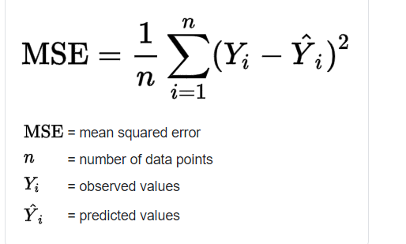
Mean squared error
It is also an important loss function for algorithms fit or optimized using the least squares framing of a regression problem. Here “least squares” refers to minimizing the mean squared error between predictions and expected values.
The MSE is calculated as the mean or average of the squared differences between predicted and expected target values in a dataset.

Slide 28
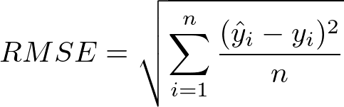
Root Mean Squared Error (RMSE).
Root mean squared error (RMSE) is the square root of the mean of the square of all of the error. The use of RMSE is very common, and it is considered an excellent general-purpose error metric for numerical predictions.

Slide 29
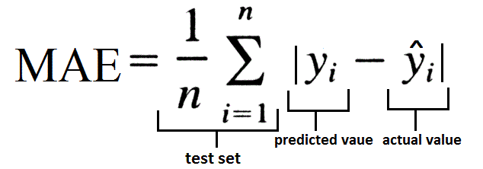
Mean absolute error
MAE score is calculated as the average of the absolute error values. Absolute or abs() is a mathematical function that simply makes a number positive. Therefore, the difference between an expected and predicted value may be positive or negative and is forced to be positive when calculating the MAE.

